Slide 1
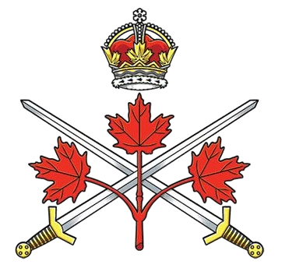
Canadian Army
World War II
Organizational Structure, Manpower,
Equipment and Operational Environment
“A Brief Overview”
© LGen E.C. Ashton Armoury Museum Hands on History Program. All Rights Reserved

Slide 2
Introduction
During the Second World War, the Canadian Army transformed from a modest peacetime force into one of the largest and most effective Allied armies and played a decisive role in the liberation of Western Europe.
At its peak, approximately 495,000 served in the Canadian Army including a full field army (250,000) overseas and sustained a massive home and training establishment. Troops were organized in two corps, each with a mix of five infantry and two armoured divisions. Each division was comprised of three brigades of three battalions or regiments. In adddition there were several independent infantry, armoured and artillery brigades.

Slide 3
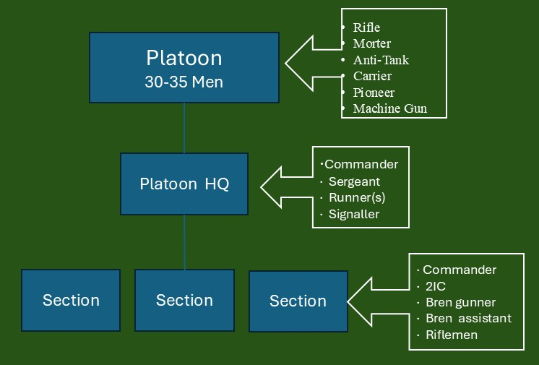
Organizational Structure
The 250,000 personnel who served overseas in the First Canadian Army were organized in two corps, each with a mix of five infantry and two armoured divisions, comprise of three brigades of three battalions or regiments and several independent infantry, armoured and artillery brigades. The battalion and regiments further comprised of companys, squadrons and batterys with platoons and troops that served as the basic tactical element of the field army. A generic infantry platoon is pictured

Slide 4
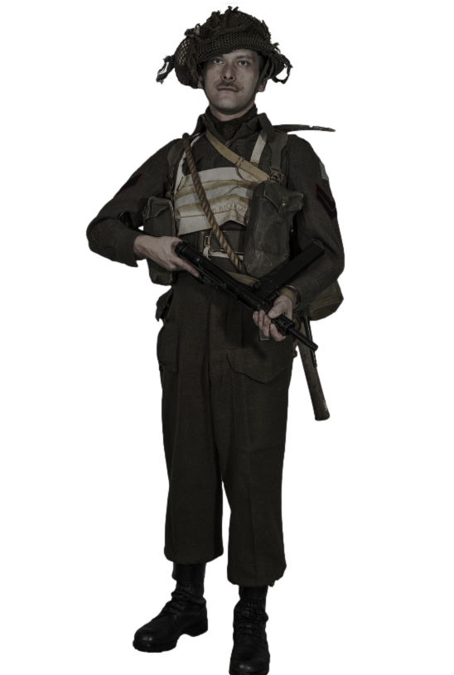
Manpower
Demographics
Predominantly male, with both English- and French-speaking Canadians.
Indigenous soldiers served in significant numbers.
Racial minorities and women participated, though often restricted to specific roles.
Women served in support positions through the Canadian Women’s Army Corps (CWAC).
Recruitment and Conscription
Initial reliance on voluntary enlistment
The National Resources Mobilization Act (NRMA)
provided manpower for home defence.
Limited overseas conscription was introduced in 1944, creating political and social tension.

Slide 5
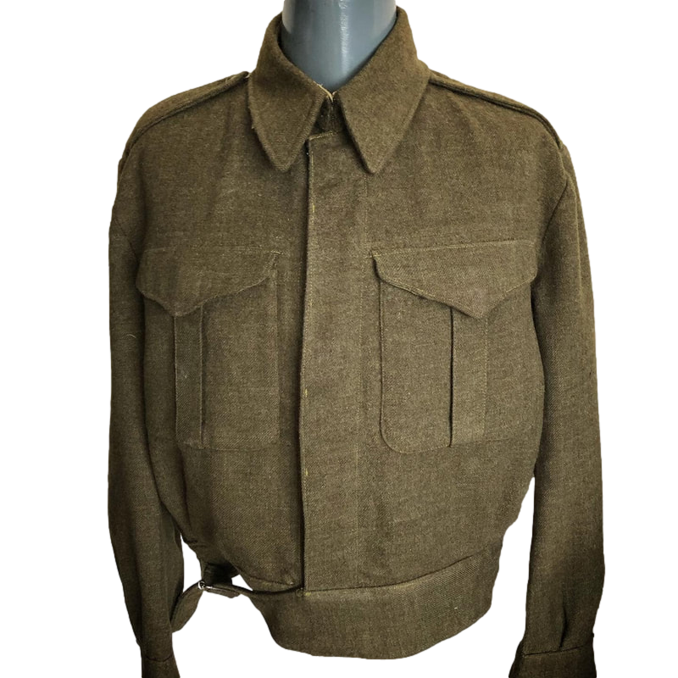
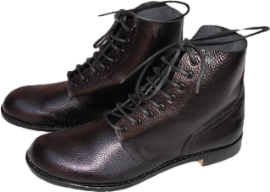
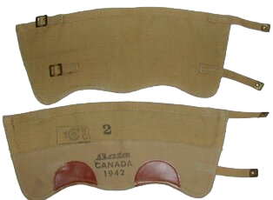
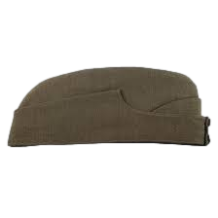
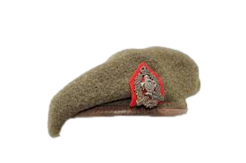
Equipment
Uniform
Battle Dress was adopted by the Canadian Army just prior to the Second World War as a replacement for the Service Dress that had been a combined field and dress uniform since the early 1900s. The uniform, consisted of two garments:
Battle Dress Blouse - a waist length, fly fronted garment of heavy wool with two breast pockets and a collar done up at the neck.
Battle Dress Trousers - loose fitting wool trousers of material matching the blouse, with buttons for braces as well as belt loops, two hip pockets, a rear pocket, and two external pockets; one on the (wearer's) upper right thigh, designed to hold a First Field Dressing, and a larger pocket on the upper left thigh, commonly called a "map pocket".
The uniform was completed with black leather ankle boots, gaters/putties and wedge cap or beret.
Soldiers were also issued a heavy wool calf length Great Coat
.

Slide 6
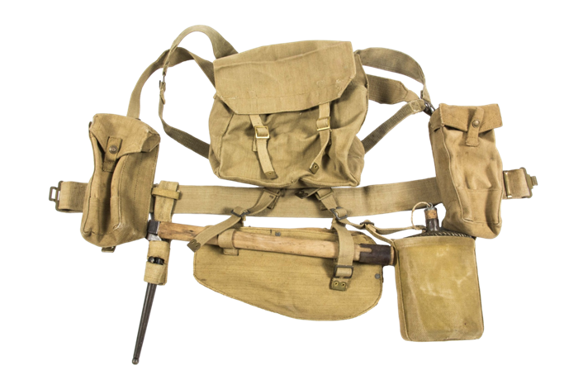
Equipment
Personal Load Bearing Equipment
1937 Pattern Canvas Webbing based on British webbing patterns but adapted slightly for Canadian production and climate conditions. Made of heavy-duty canvas, dyed khaki or olive drab. Desiged to distribute the weight of equipment evenly across the shoulders and waist, making long marches and combat operations more manageable.
Components
Belt: Wide canvas belt, adjustable, forming the base of the system.
Brace (Shoulder Straps): “H-style” suspenders that cross the back and attach to the belt to helped distribute the weight of ammo pouches, canteens, and entrenching tools.
Ammunition Pouches: Usually, two or three small pouches on the front belt for rifle magazines (Lee-Enfield SMLE No. 1 Mk III)
Canteen and Carrier: A metal or plastic canteen in a khaki cloth carrier, usually hung on the belt or shoulder strap.
Bayonet Frog / Scabbard: Leather or webbing loop for carrying the No. 4 Mk I bayonet.
Entrenching Tool Carrier: Small pocket for a folding shovel worn on the belt at the rear or side.
Haversack / Pack: Small backpack attached to the belt braces for carrying extra clothing, rations, a blanket and/or poncho.
.

Slide 7
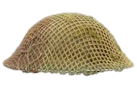
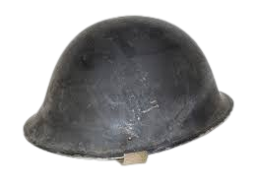
Equipment
Helmet
Early war the Brodie MK I helmet; a design inherited from the British Army. Circular, shallow bowl with a wide brim all around. The brim is slightly flared, providing basic ballistic protection against artillery fragments and debris, not bullets. Initially olive drab or brownish-green and often worn with netting, foliage, or cloth covers for additional camouflage.
Mid-war the MKII was replaced by the MKII or “Turtle” helmet providing better coverage for top, sides, and back of head, slightly thicker in key areas for improved protection and with abetter and more comfortable fitting liner
.
Brodie Mk I Helmet (circa 1939)
Mk IV Turtle Helmet (circa 1944)

Slide 8
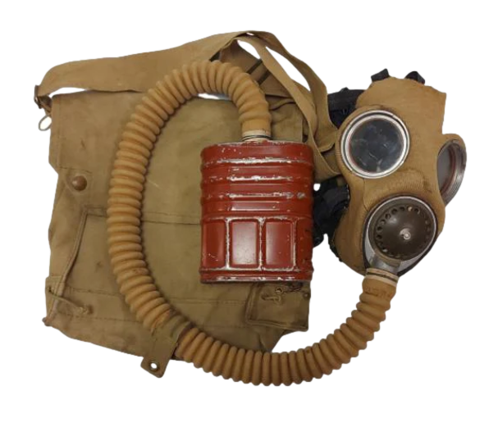
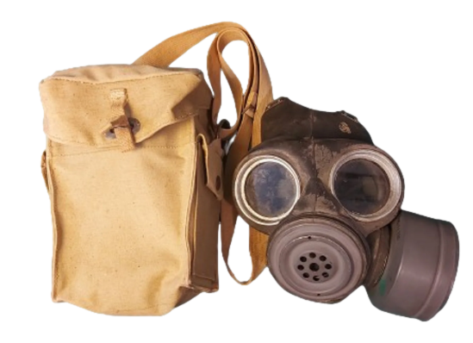
Equipment
Gas Mask
British General Service Respirator (GSR), with Canadian-manufactured variants. The Gas Mask, made of rubberized fabric (early war) or improved rubber compounds (later war), covered the entire face, sealing around the cheeks and chin. Two round celluloid or glass lenses set in metal or rubber rims provided a wide field of vision but were prone to fogging in damp or cold conditions. A filter canister attached directly to the mask (early) or via a hose (later variants). contained layers of charcoal and chemical absorbents designed to neutralize poison gases. One-way valve reduced moisture buildup inside the mask. The Gas Mask Bag was worn high on the chest in forward areas so the mask could be donned in seconds. When gas threat was low, the bag might be worn on the hip or slung, bag contained: mask, spare anti-dimming lens wipes and sometimes a small instruction card
.
Canadian Mk IV Respirator (circa 1942)
Light Anti-Gas Respirator Mk II (circa 1944)

Slide 9
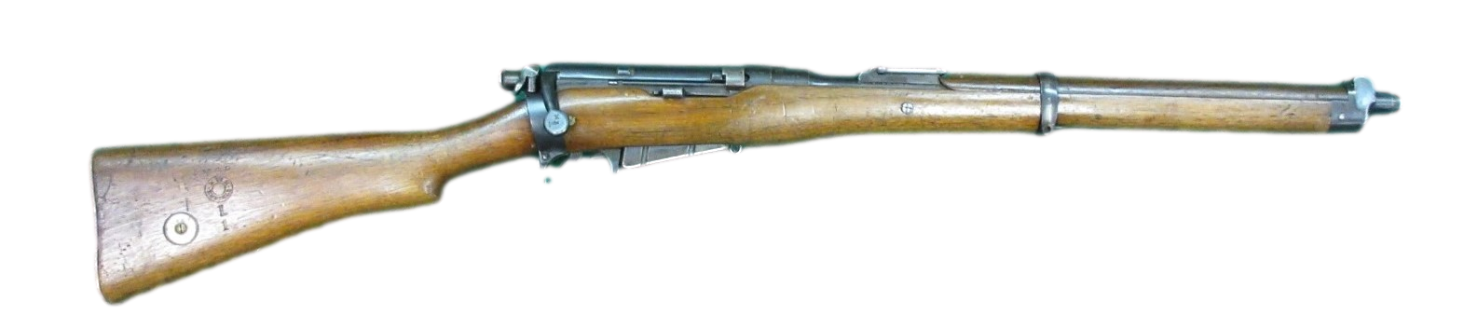
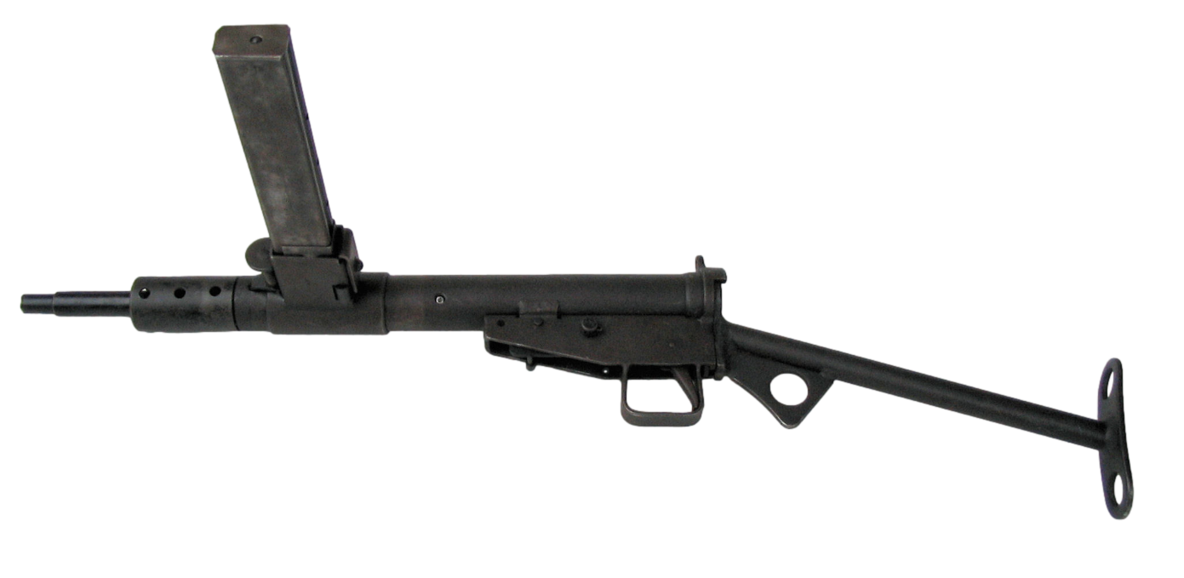
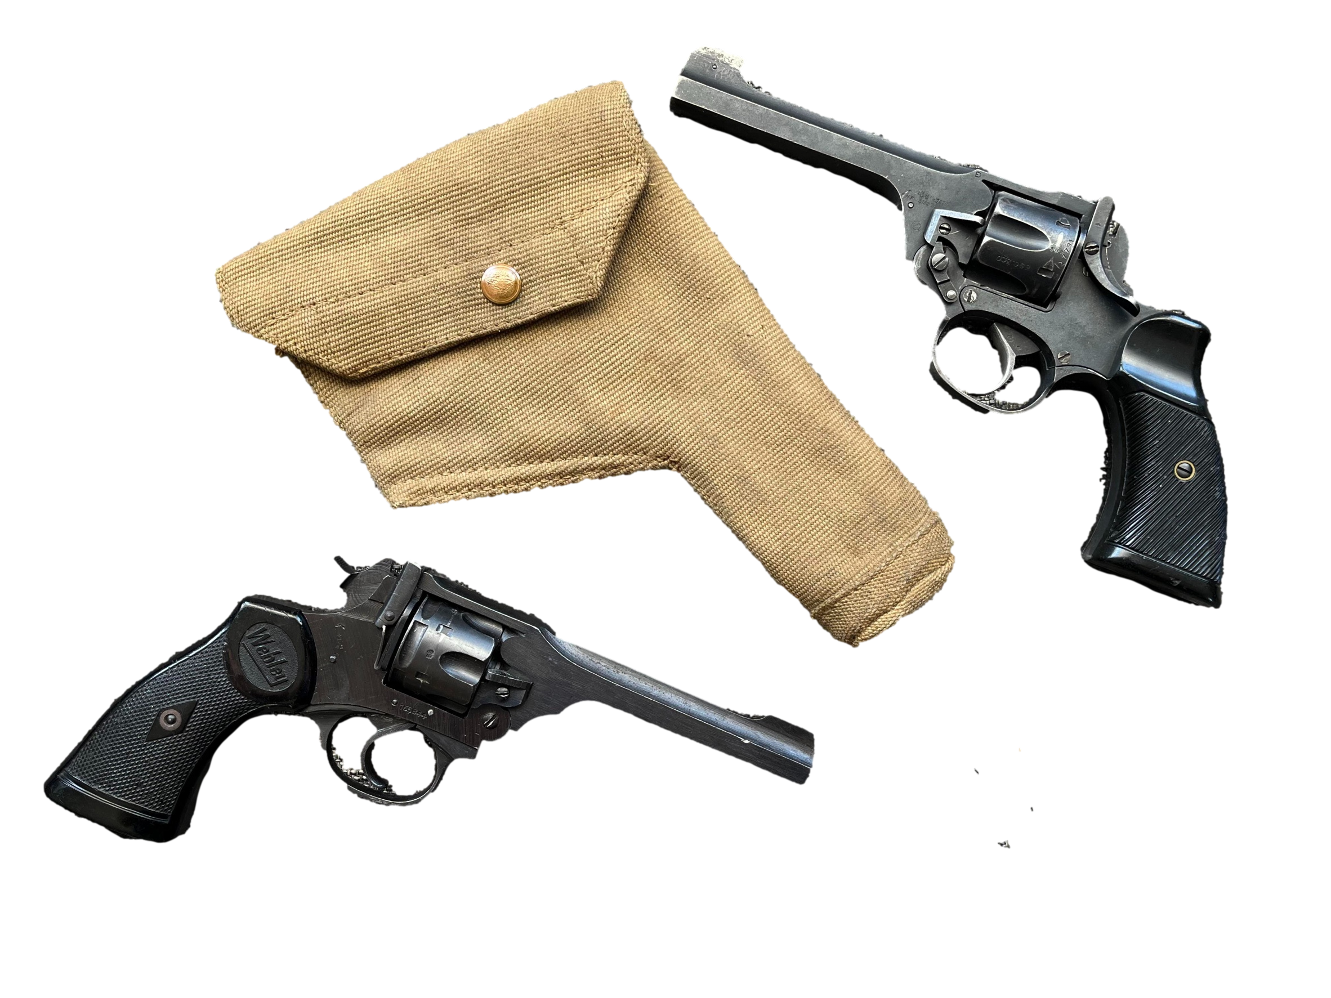
Equipment
Personal Weapon
The primary weapon was the bolt action British 303 caliber Lee-Enfield Rifle No 4 Mk1 with a wooden stock, steel barrel and receiver with an exceptionally fast rate of fire for a bolt rifle. It had a 10-round detachable box magazine loaded using 5-round stripper clips (magazine normally not removed in the field). Rifleman typically carried 50-100 rounds of .303 ammunition. The effective range was ~300–500 metres for aimed fire and longer ranges possible with volley or area fire. The rife was fitted with the No. 4 Spike Bayonet for close combat.
Secondary personal weapons included:
the full-automatic 9×19 mm Parabellum Sten Submachine Gun was valued for simplicity and volume of fire for close quarters fighting and urban combat; and
the .38 calibre Webley Mk IV and Enfield No. 2 revolvers. They generally issued to officers, NCOs ad specialists (signallers, drivers) and were Not intended as a primary combat weapon
.

Slide 10
Operational Environment
Battlefield Conditions
Unlike WWI which was relatively static, WWII was largely a war of movement fought across a variety of terrains, from the harsh terrain of the Italian Campaign with steep mountains, narrow valleys, muddy rivers to the thick hedges of Normandy which divided field into natural fortresses. This demanded adaptability to fight across diverse landscapes in a fast-moving, mechanized war
Living Conditions
Although generally better supplied than in WWI, soldiers still endured:
Long periods in foxholes.
Exposure to rain, snow, and cold.
Limited bathing opportunities.
Sleep deprivation.
Continuous artillery fire.
Field kitchens and improved logistics usually provided more reliable food than during WWI

Slide 11
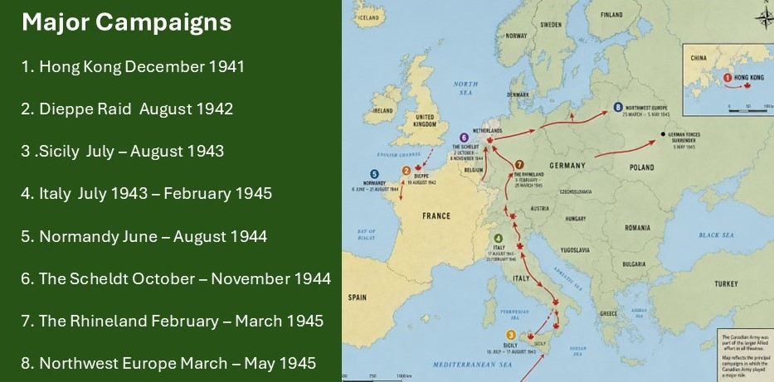
Operational Environment

Slide 12
THE END

Slide 13
THE END

