Slide 1
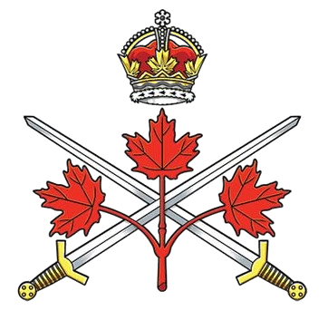
Canadian Army
World War I
Organizational Structure, Manpower,
Equipment and Operational Environment
“A Brief Overview”
© LGen E.C. Ashton Armoury Museum Hands on History Program. All Rights Reserved

Slide 2
Introduction
During the First World War (WWI), the Canadian Army was organized differently from the small pre-war militia that existed in 1914. The force that fought overseas was officially known as the Canadian Expeditionary Force (CEF), while the Permanent Active Militia and Non-Permanent Active Militia remained in Canada for training and home defence. Over 620,000 Canadians and Newfoundlanders (Newfoundland was then a separate British dominion) served during the war, with more than 66,000 losing their lives.
By the final campaigns of 1917–1918, the Canadian Corps had evolved into one of the most effective formations on the Western Front. Its combination of strong artillery support, integrated engineers and machine guns, and flexible infantry organization contributed significantly to victories at Vimy Ridge, Hill 70, Passchendaele, Amiens, the Drocourt-Quéant Line, Canal du Nord, and Mons.

Slide 3
Organizational Structure
The principal fighting formation was the Canadian Corps, formed in September 1915. The Corps was comprised of four infantry divisions together with supporting heavy artillery, engineer, supply & transport and medical units. The divisions were further comprised of three infantry brigades with battalion, regiments, companies and platoons the latter being the basic tactical element of the Corps. A generic infantry platoon is pictured
Infantry Platoon
35 – 40 Men
Headquarters
Rifle Section
Lewis Gun Section
Hand Grenade Section
Rifle Grenade Section

Slide 4
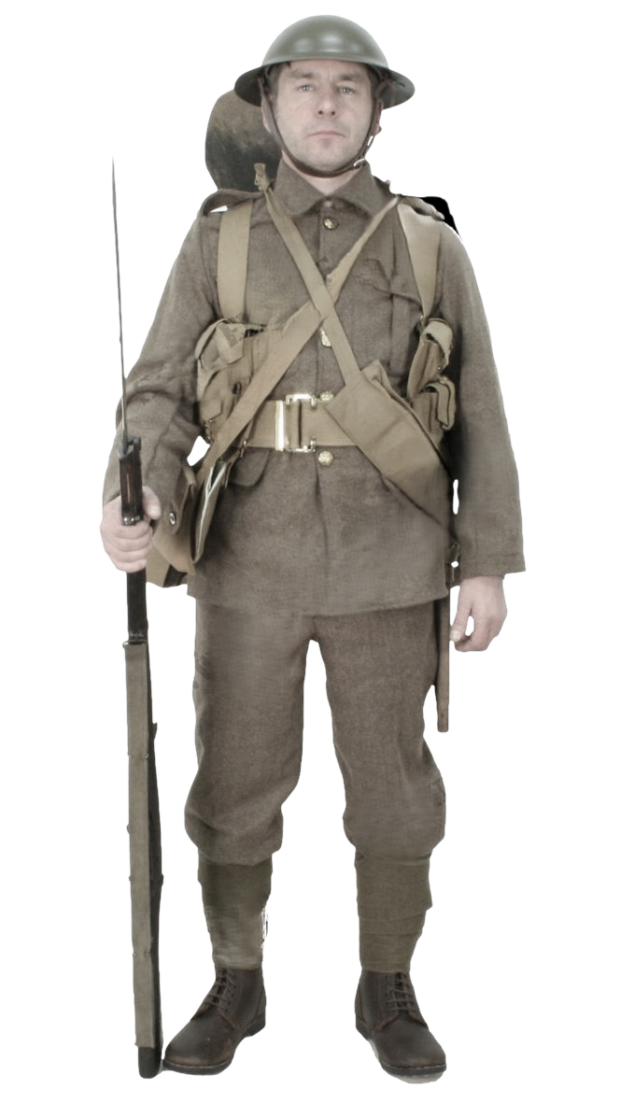
Manpower
Demographics
The average Canadian soldier evolved over the course of the war.
Age: Most volunteers were between 18 and 35 years old, although many underage boys and some older men also enlisted.
Occupation: Early recruits often came from rural communities and worked as farmers, laborers, loggers, miners, or tradesmen. As the war continued, more clerks, factory workers, and professionals joined.
Nationality: Canada's population was heavily British in origin, and a large proportion of early volunteers had been born in Britain rather than Canada. Many recent immigrants enlisted out of loyalty to the British Empire.

Slide 5
Manpower
Indigenous Soldiers: More than 4,000 First Nations men served,
French Canadians: Recruitment among French Canadians was lower than among English Canadians in the divisive Conscription Crisis of 1917.
Black Canadians: Initially rejected Black volunteers eventually served, most notably with the No. 2 Construction Battalion, although some served in combat units.
Recruitment and Training
Initial reliance was on voluntary enlistment
New recruits were sent to Valcartier Camp, Quebec, they received basic training. Further training was provided in England before joining battalions at the front in France and Belgium.
By 1917, voluntary enlistment had slowed dramatically, leading to the Military Service Act, which introduced conscription.

Slide 6
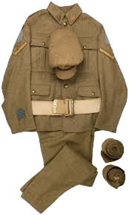
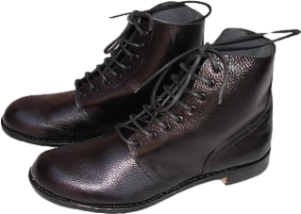
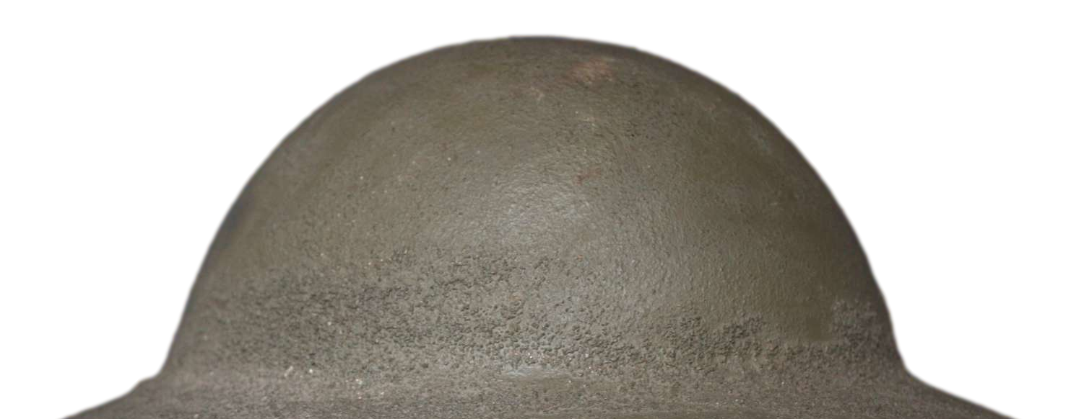
Equipment
Uniform
Canadian soldiers wore uniforms like those of the British Army, with some unique distinctions over time.
Standard Uniform:
Tunic: A khaki wool service tunic with large external pockets and high collar (stand-and-fall style early in the war, later replaced by an open collar with shirt and tie).
Trousers: Matching khaki wool trousers, usually tucked into puttees (long (8’) woolen wraps around the lower leg
Headgear:
Early War: A soft cap known as the “trench cap"
Later War: The steel Brodie helmet, introduced around 1916, to protect from shrapnel.
Footwear:
Sturdy leather ankle boots known as “ammunition boots”.
.

Slide 7
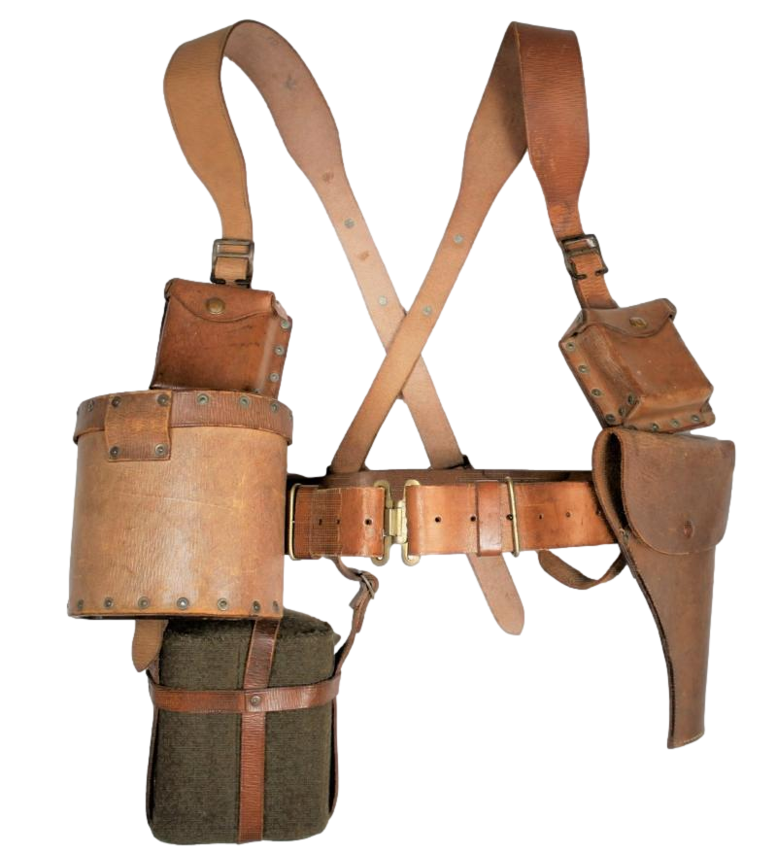
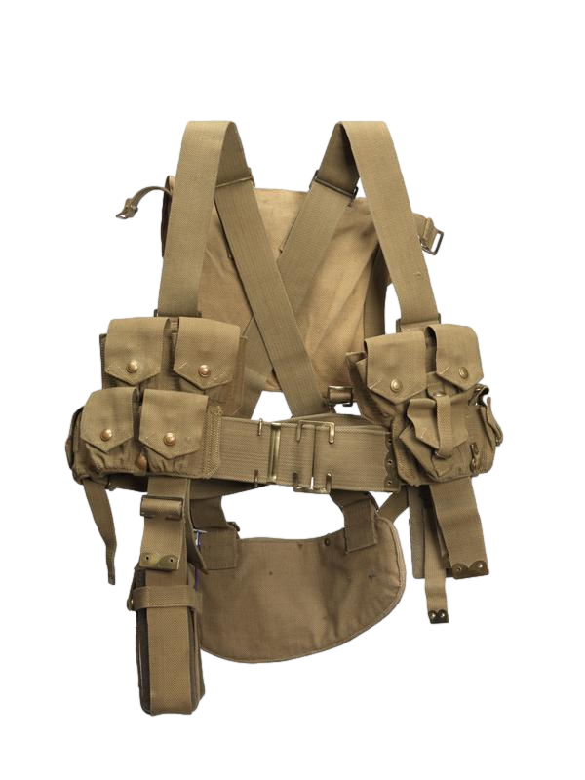
Equipment
Personal Load Bearing Equipment
Early War:
1889 Oliver Pattern leather harness and pouches
Later War:
1908 Pattern Web Equipment (canvas webbing)
Water bottle
Entrenching tool (small shovel)
Haversack and pack
Mess tin and eating utensils
Groundsheet or waterproof cape
Extra socks and personal items
First aid field dressing
Gas mask (Small Box Respirator after 1916)
Ammunition pouches carrying approximately 150 rounds
A fully equipped infantryman often carried 60 to 70 pounds (27–32 kg) of gear.
.

Slide 8
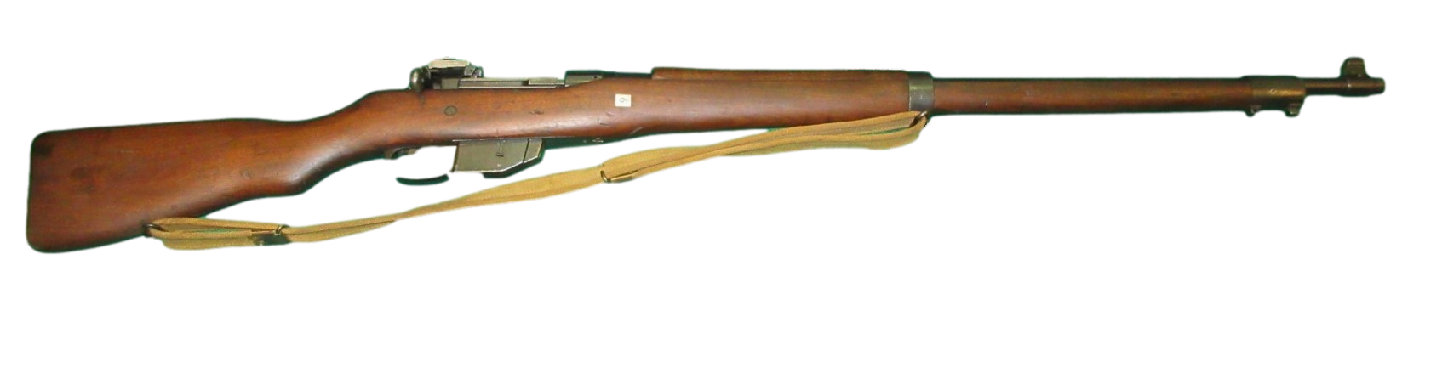
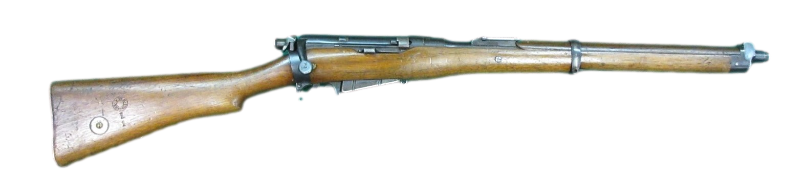
Equipment
Personal Weapon
The standard-issue weapon for Canadian infantrymen was:
Ross Rifle (1905–1916)
Canadian-made straight-pull bolt-action rifle.
Accurate but unreliable in trench conditions (mud and dirt jammed the mechanism).
Strongly disliked by soldiers for jamming during combat.
Lee-Enfield Rifle (after 1916)
SMLE Mk III (Short Magazine Lee-Enfield):
A reliable British-made bolt-action rifle.
10-round magazine, fast cycling rate.
Widely praised for its dependability and firepower.
Became the standard issue by mid-war.
Bayonet: The standard bayonet was the Pattern 1907 sword bayonet, featuring a 17-inch blade. Soldiers were trained extensively in bayonet fighting, though actual bayonet combat was less common
Ross Rifle
.
Lee-Enfield Rifle

Slide 9
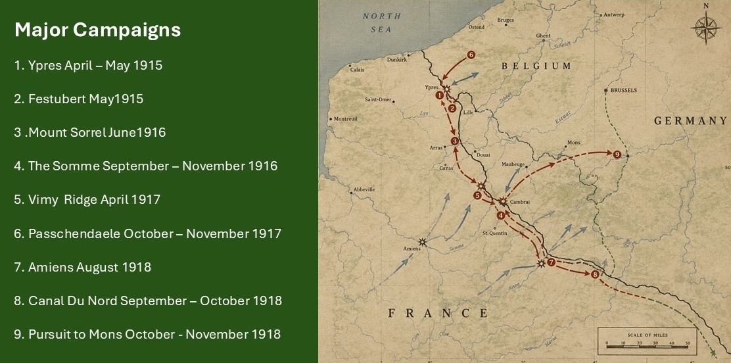
Operational Environment

Slide 10
Operational Environment
Battlefield Conditions
The defining feature of the Western Front was the extensive trench system stretching troops spent much of their service living and fighting and endured:
Heavy rain and shellfire destroyed drainage systems, turning trenches into waist-deep mud.
Trenches often flooded, leaving soldiers standing in cold water for days.
Winters which brought freezing temperatures and snow, while summers could become oppressively hot and filled with insects; and
Constant shelling was responsible for roughly 60% of battlefield casualties.
Living Conditions
Front-line tours usually lasted several days with troops subjected to:
Poor sanitation.
Infestations of rats, lice, and fleas.
Limited opportunities to wash.
Shortages of fresh food.
Sleeping in dugouts carved into trench walls.

Slide 11
THE END

